Slide 1
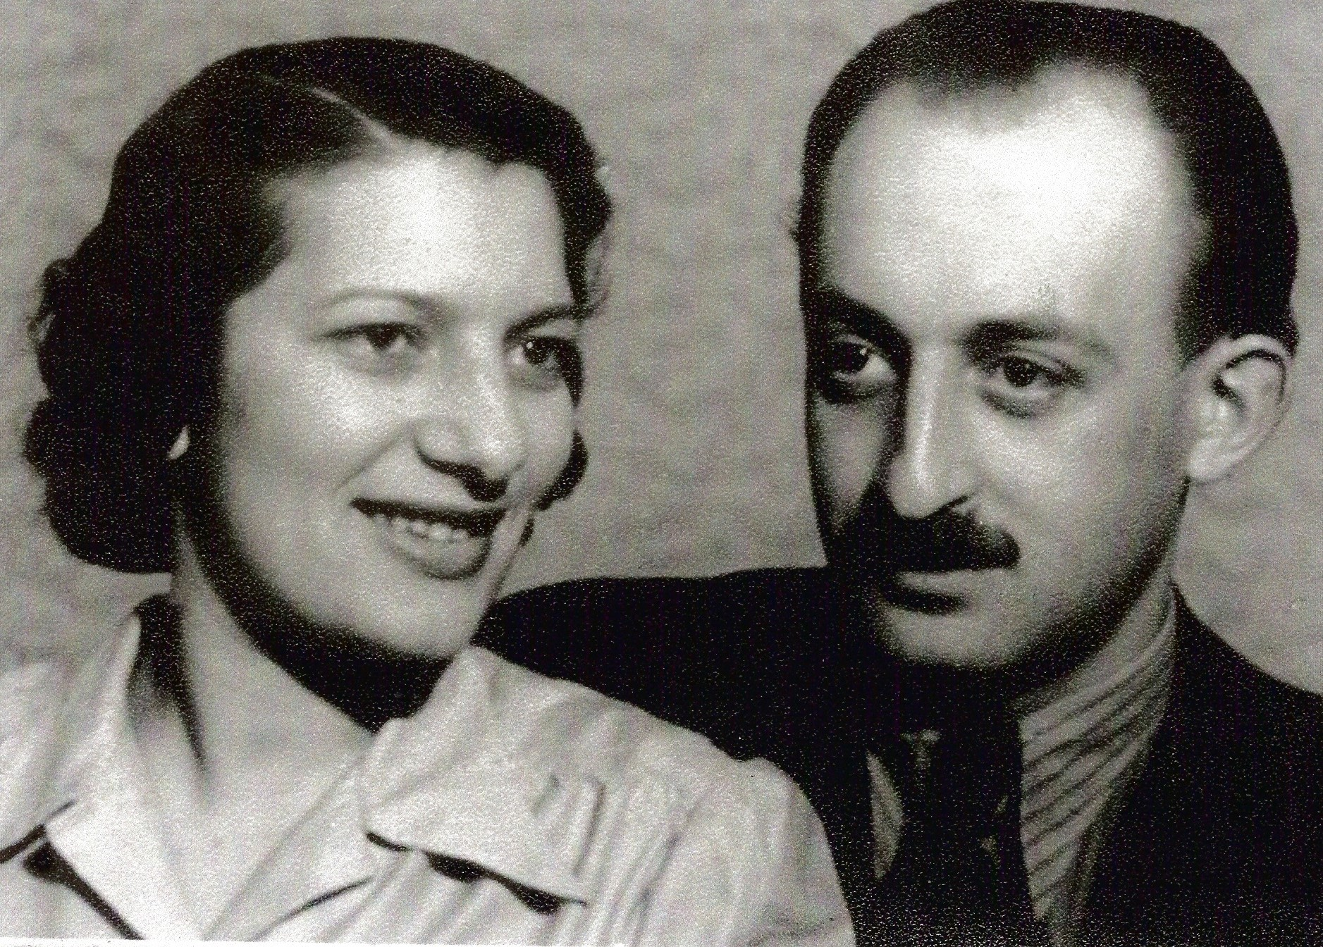
Hana’s parents 1941

Slide 2
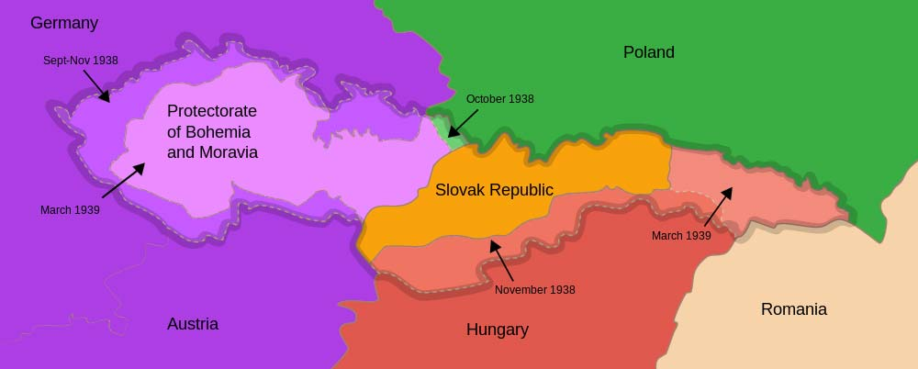
Occupation of Czechoslovakia by German, Polish and Hungarian armies

Slide 3
Dr. Josef Mengele in 1943
His accomplishments
Selections:
Left – death
Right-Work

Slide 4
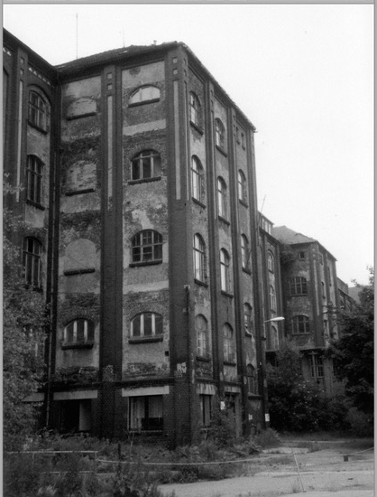
Arado factory for planes
Freiberg
today

Slide 5
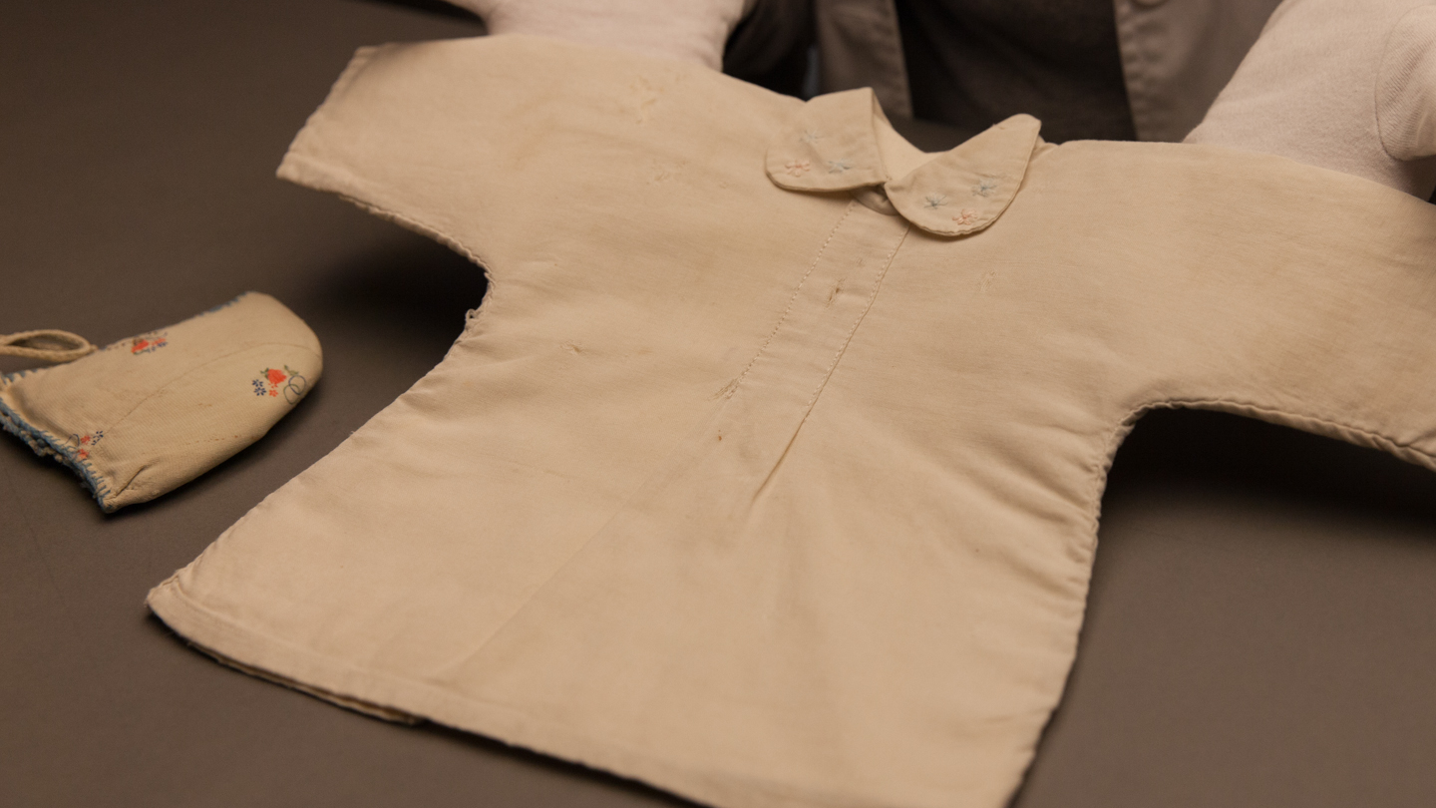

Slide 6
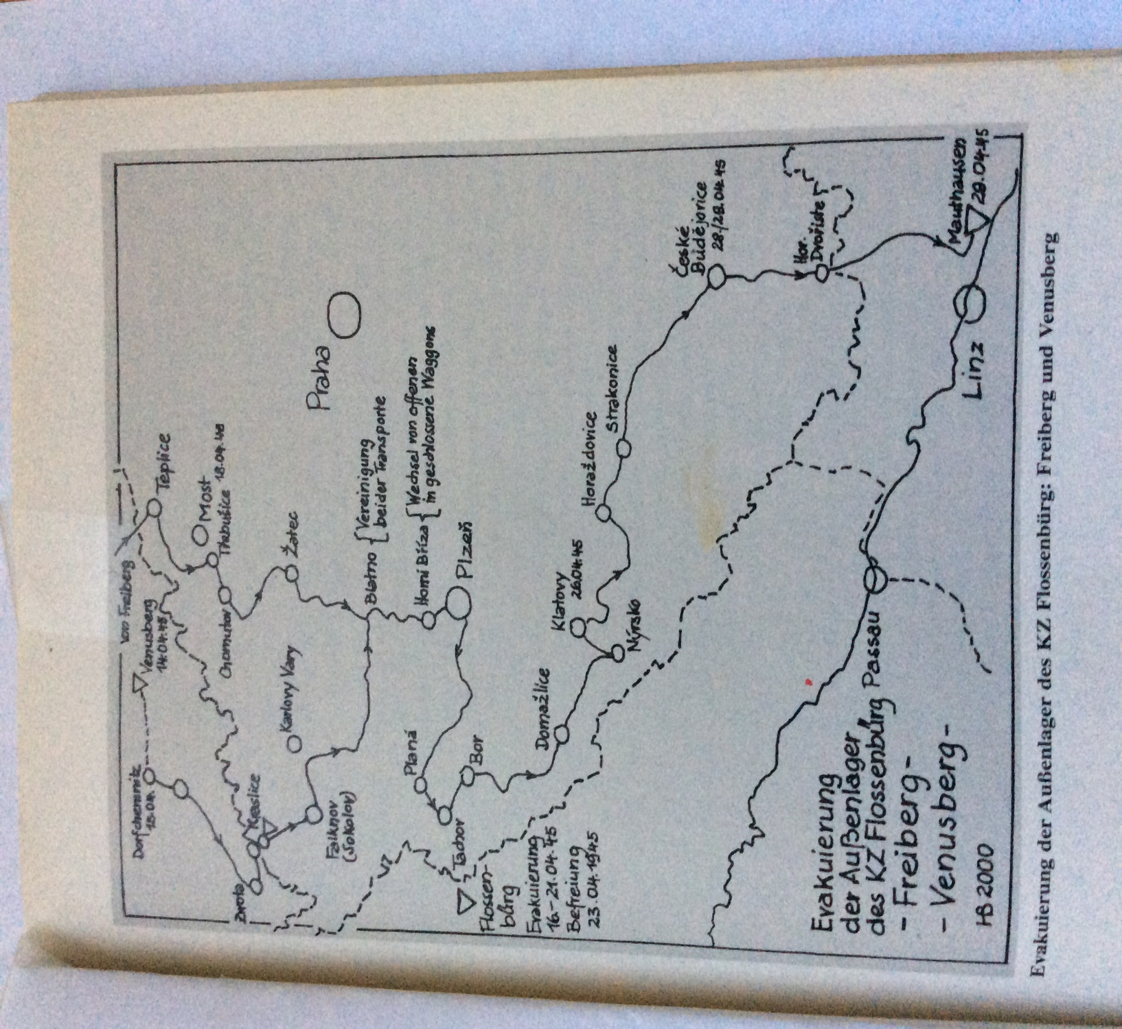
Death Transport
Freiberg to Mauthausen
17 days
April 14 to 29 1945

Slide 7
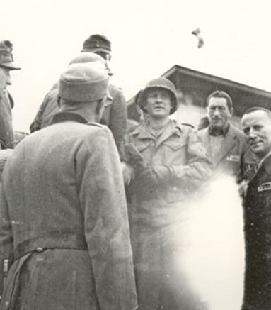
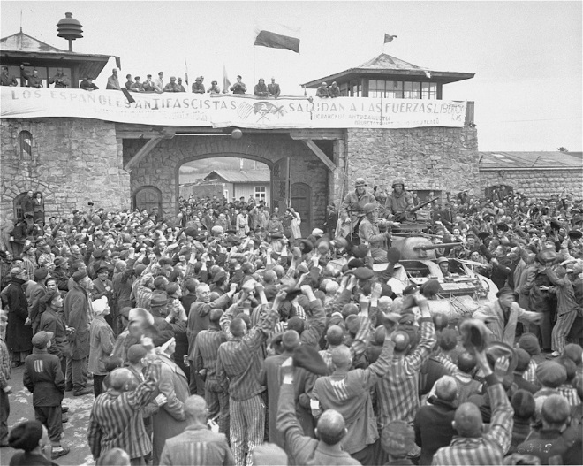
11th Armored Division, 3rd US Army- Liberating Mauthausen
May 5, 1945
Notes:
Slide needs a mouse click to advance.

Slide 8
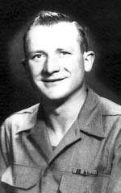
Gusen and Mauthausen Camps Liberator (Officer)
S SGT. Albert Kosiek

Slide 9
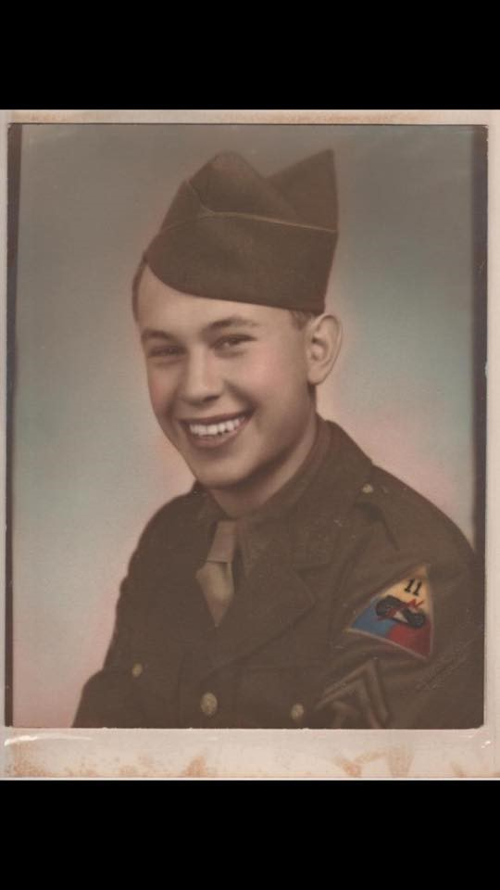
Leroy (Pete) Petersohn
Liberator-Medic,
3rd Army
11th Armored Division

Slide 10
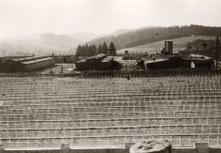
Mauthausen camp back view with unmarked graves

